Slide 1
C++ INHERITANCE
BY Samwel Tarus

Slide 2
Definition / Concepts
The mechanism of deriving a new class from the existing / old class.
The process in which one class acquires some / all the properties and behaviors of its parent class
Base class, super class, parent class
Derived class, subclass, child class
Nb: The derived class inherits some/all of the properties from the base class
A class can inherit properties from more than one class or from more than one level

Slide 3
Advantages of C++ Inheritance
Code-reusability
Code readability
Reusability enhanced reliability. The base class code will be already tested and debugged.
As the existing code is reused, it leads to less development and maintenance costs.
Inheritance makes the sub classes follow a standard interface.
Inheritance helps to reduce code redundancy and supports code extensibility.
Inheritance facilitates creation of class libraries.
It improves the program structure which can be readable.
The program structure is short and concise which is more reliable.
The codes are easy to debug.

Slide 4
Disadvantages of C++ Inheritance
Inherited functions work slower than normal function as there is indirection.
Improper use of inheritance may lead to wrong solutions.
Often, data members in the base class are left unused which may lead to memory wastage.
Inheritance increases the coupling between base class and derived class. A change in base class will affect all the child classes.

Slide 5
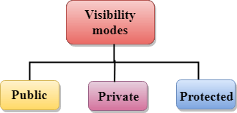
Visibility modes
Public: When the member is declared as public, it is accessible to all the functions of the program.
Private: When the member is declared as private, it is accessible within the class only.
Protected: When the member is declared as protected, it is accessible within its own class as well as the class immediately derived from it.

Slide 6
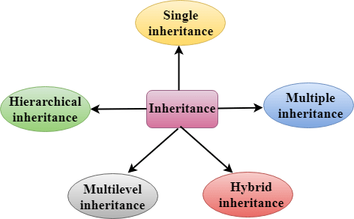
Types Of Inheritance
Single inheritance
Multiple inheritance
Hierarchical inheritance
Multilevel inheritance
Hybrid inheritance

Slide 7
Derived Classes
A Derived class is defined as the class derived from the base class.
Syntax
class derived_class_name : visibility-mode base_class_name
{
// body of the derived class.
}
Where,
derived_class_name: It is the name of the derived class.
visibility mode: The visibility mode specifies whether the features of the base class are publicly inherited, protected, or privately inherited. It can be public or private.
base_class_name: It is the name of the base class.

Slide 8
Modes of Inheritance
Private mode
Protected mode
Public mode

Slide 9
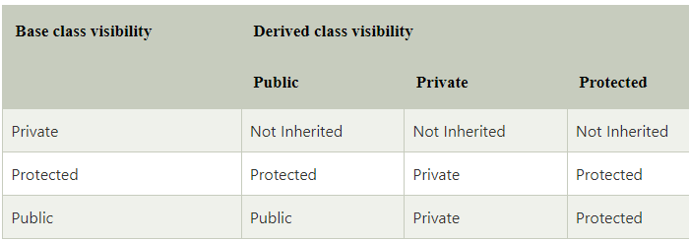
Visibility of Inherited Members

Slide 10
Pto…
When the base class is privately inherited by the derived class, public members of the base class becomes the private members of the derived class. Therefore, the public members of the base class are not accessible by the objects of the derived class only by the member functions of the derived class.
When the base class is publicly inherited by the derived class, public members of the base class also become the public members of the derived class. Therefore, the public members of the base class are accessible by the objects of the derived class as well as by the member functions of the base class.
Nb:
In C++, the default mode of visibility/inheritance is private.
The private members of the base class are never inherited.

Slide 11

C++ Single Inheritance
Mechanism in which a derived class acquires the properties from a single base class
Where 'A' is the base class, and 'B' is the derived class.

Slide 12
#include <iostream>
using namespace std;
class Account {
public:
float salary = 60000;
};
class Programmer: public Account {
public:
float bonus = 5000;
};
int main(void) {
Programmer p1;
cout<<"Salary: "<<p1.salary<<endl;
cout<<"Bonus: "<<p1.bonus<<endl;
return 0;
}
//single inheritance
#include<iostream>
//#include<conio.h>
// Base class
class Shape {
public:
void setWidth(int w) {
width = w;
}
void setHeight(int h) {
height = h;
}
protected:
int width;
int height;
};
class Rectangle : public Shape {
public:
int getArea() {
return (width * height);
}
};
int main() {
Rectangle Rect;
Rect.setWidth(5);
Rect.setHeight(7);
// Print the area of the object.
std::cout << "Total area: " << Rect.getArea()<<"\n";
return 0;
}

Slide 13
Single privately inherited
class B : private A {
public:
void display() {
int result = mul();
std::cout <<"Multiplication of a and b is : "<<result<< std::endl;
}
};
int main() {
B b;
b.display();
return 0;
}
#include <iostream>
using namespace std;
class A {
int a = 4;
int b = 5;
public:
int mul() {
int c = a*b;
return c;
}
};

Slide 14

C++ Multilevel Inheritance
The process of deriving a class from another derived class.

Slide 15
Multilevel inheritance program
class C : public B {
public:
void show() {
std::cout<<"\nmember of class C\n";
}
};
int main() {
C c;
B b;
b.display();
c.display();
c.show();
return 0;
}
//multilevel inheritance
#include<iostream>
class A {
public:
void display() {
std::cout<<"Base class content.";
} };
class B : public A {
public:
void display(){
std::cout<<"B class content.\n";
} };

Slide 16
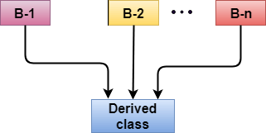
C++ Multiple Inheritance
The process of deriving a new class that inherits the attributes from two or more classes.
The process where a single derived class acquires the properties of more than base class.

Slide 17
Syntax
class Derived : visibility B-1, visibility B-2, visibility B-3,
{
// Body of the class;
}

Slide 18
Demo Program
class C : public A,public B {
public:
void display() {
std::cout << "The value of a is : " <<a<< std::endl;
std::cout << "The value of b is : " <<b<< std::endl;
cout<<"Addition of a and b is : "<<a+b;
} };
int main() {
C c;
c.get_a(10);
c.get_b(20);
c.display();
return 0;
}
#include <iostream>
using namespace std;
class A {
protected:
int a;
public:
void get_a(int n)
{
a = n;
} };
class B {
protected:
int b;
public:
void get_b(int n) {
b = n;
} };

Slide 19
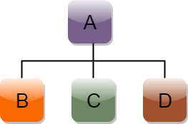
C++ Hierarchical Inheritance
class A
{
// body of the class A.
}
class B : public A
{
// body of class B.
}
class C : public A
{
// body of class C.
}
class D : public A
{
// body of class D.
}

Slide 20
Program example
class Triangle : public Shape // inheriting Shape class
{
public:
int triangle_area() {
float result = 0.5*a*b;
return result;
} };
int main() {
Rectangle r;
Triangle t;
int length,breadth,base,height;
std::cout << "Enter the length and breadth of a rectangle: " << std::endl;
cin>>length>>breadth;
r.get_data(length,breadth);
int m = r.rect_area();
std::cout << "Area of the rectangle is : " <<m<< std::endl;
std::cout << "Enter the base and height of the triangle: " << std::endl;
cin>>base>>height;
t.get_data(base,height);
float n = t.triangle_area();
std::cout <<"Area of the triangle is : " << n<<std::endl;
return 0;
}
#include <iostream>
using namespace std;
class Shape // Declaration of base class.
{
public:
int a;
int b;
void get_data(int n,int m) {
a= n;
b = m;
}
};
class Rectangle : public Shape // inheriting Shape class
{
public:
int rect_area() {
int result = a*b;
return result;
}
};

Slide 21
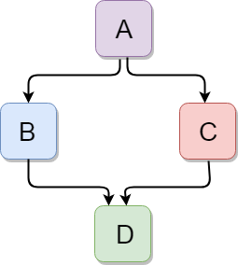
C++ Hybrid Inheritance
combination of more than one type of inheritance.

Slide 22
#include <iostream>
using namespace std;
class A
{
protected:
int a;
public:
void get_a()
{
std::cout << "Enter the value of 'a' : " << std::endl;
cin>>a;
}
};
class B : public A
{
protected:
int b;
public:
void get_b()
{
std::cout << "Enter the value of 'b' : " << std::endl;
cin>>b;
}
};
class C
{
protected:
int c;
public:
void get_c()
{
std::cout << "Enter the value of c is : " << std::endl;
cin>>c;
}
};
class D : public B, public C
{
protected:
int d;
public:
void mul()
{
get_a();
get_b();
get_c();
std::cout << "Multiplication of a,b,c is : " <<a*b*c<< std::endl;
}
};
int main()
{
D d;
d.mul();
return 0;
}

Slide 23
Class assignment:
Write short notes on:
Virtual base classes
Abstract classes
Constructors in derived classes

Slide 24


